Slide 1


Traffic sign recognition
MATURI VENKATA SUBBA RAO(MVSR) ENGINEERING COLLEGE
Nadergul, Hyderabad – 501510
(Sponsored by Matrusri Education Society, Estd. 1980)
Approved by AICTE & Affiliated to Osmania University, Estd. 1981
ISO 9001:2015 Certified Institution, Accredited by NAAC
Website: www.mvsrec.edu.in
(An Autonomous Institution)
DEPARTMENT OF INFORMATION TECHNOLOGY
TEAM NO:B6
Team details
2451-21-737-071 VEERLA DEEKSHA
2451-21-737-072 SURAJ REDDY DOMMATA
2451-21-737-080 SILVEERI LOKESH
DETAILS OF INTERNSHIP
Name : AICTE-Eduskills
Domain : Data Science
Duration : 10 weeks

Slide 2
ABSTRACT
Traffic sign recognition is a crucial component of Advanced Driver Assistance Systems (ADAS) that enhances road safety and driving efficiency. This project focuses on developing an accurate and robust traffic sign recognition system using advanced machine learning algorithms, specifically deep learning models, to analyze and interpret traffic signs in real-time, ultimately contributing to the enhancement of autonomous driving systems. By training on a diverse dataset of traffic sign images, the system learns to recognize various signs, such as speed limits, stop signs, and warnings, even under different lighting and weather conditions. The primary goal is to integrate this recognition system into ADAS technology to assist drivers by providing timely and accurate information about road signs, thereby reducing accidents and improving overall driving experience. The project aims to create a robust, real-time solution that enhances safety and navigation for drivers.

Slide 3
INTRODUCTION
Traffic Sign Recognition (TSR) is a key technology for autonomous vehicles and driver-assistance systems, allowing real-time identification of road signs. Using Convolutional Neural Networks (CNN), TSR can accurately classify traffic signs, improving road safety and driving efficiency.
PROBLEM STATEMENT
The goal of this project is to develop a deep learning model using Convolutional Neural Networks (CNN) to automatically recognize and classify traffic signs from images. The challenge lies in accurately identifying a wide variety of signs in real-time, despite environmental factors like lighting changes, occlusions, and different angles, to enhance road safety and support autonomous driving systems.

Slide 4
EXISTING SYSTEM
Existing traffic sign recognition systems rely on traditional image processing techniques or simpler machine learning models, but often struggle with accuracy under varying environmental conditions.
PROPOSED SYSTEM
The proposed system uses a Convolutional Neural Network (CNN) for accurate and real-time traffic sign recognition, capable of handling diverse sign types and challenging environmental conditions like varying lighting and occlusions.
SCOPE
The scope of this project involves designing and implementing a Convolutional Neural Network (CNN) model for recognizing and classifying traffic signs from the GTSRB dataset. It covers the preprocessing of image data, building and training the CNN, and evaluating its accuracy and performance. The project aims to achieve real-time sign recognition, making it applicable to autonomous vehicles and driver-assistance systems.

Slide 5
Software requirements
Operating System : Windows OS
IDE : Any Python IDE
Libraries : Keras, TensorFlow, Matplotlib, Pandas, Pillow, Scikit-learn
Technology : Python 3.10

Slide 6
Hardware requirements
Processor : Multi-core processor for better performance, preferably Intel Core i3 or higher.
RAM : At least 4GB RAM, though 8GB or more is recommended for better performance.
Storage : Enough disk space to store files and any other data your application might generate. 50GB or more is usually sufficient.

Slide 7
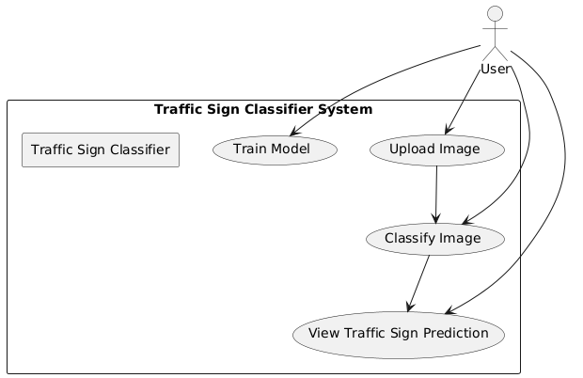
UML Diagrams
USECASE DIAGRAM

Slide 8
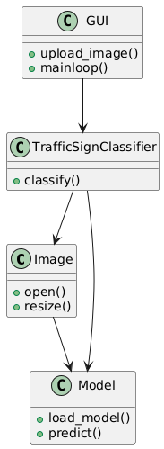
CLASS DIAGRAM

Slide 9
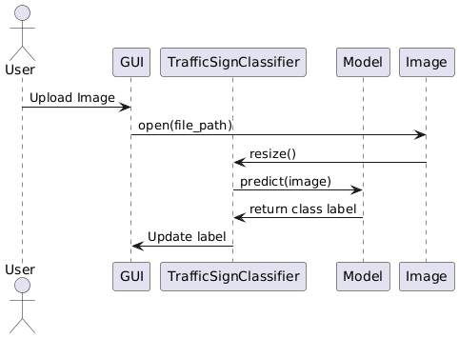
SEQUENCE DIAGRAM

Slide 10
CONCLUSION
The development of a traffic sign recognition system using Convolutional Neural Networks (CNN) presents a significant advancement in enhancing road safety and supporting autonomous driving technologies. By accurately identifying and classifying a wide variety of traffic signs in real-time, this system addresses critical challenges posed by environmental factors and improves the reliability of driver-assistance systems. The successful implementation of this project can pave the way for further enhancements, such as integrating real-time capabilities and expanding the model to accommodate additional sign types. Overall, this work contributes to the ongoing efforts in creating safer and more efficient transportation solutions.

